Slide 1
Groups
Groups

Slide 2
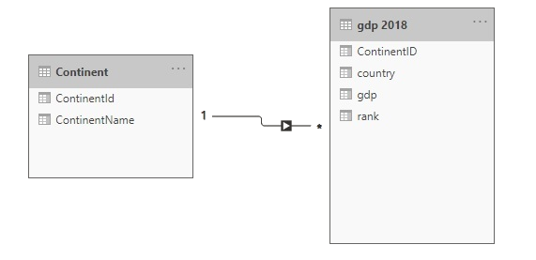
Groups
Note: This workshop uses the gdp.xlsx file located in the folder resources \ Drillthrough and Filter .
Navigate to the location of the gdp.xlsx file and load both the continent and gdp 2018 tables into the query editor.
Check that the relationship between continent and gdp 2018 is established.

Slide 3
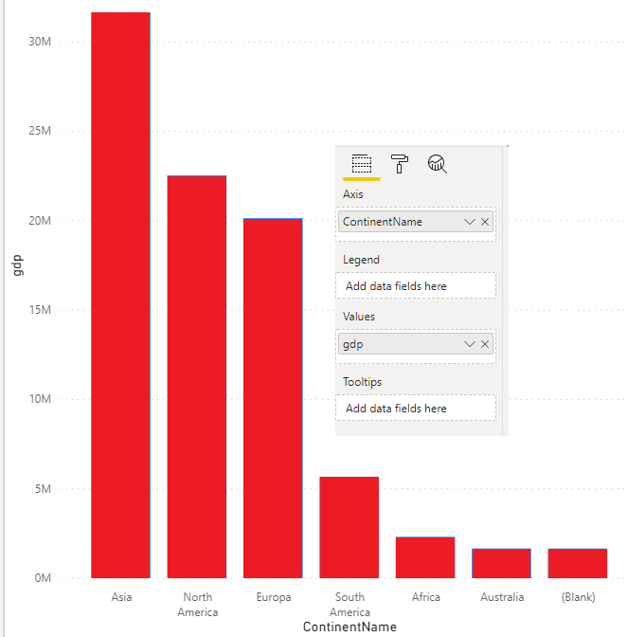
Groups
Add a Clustered Columns Histogram visual to the scene and drag ContinentName and gdp to the Axis and Values properties respectively.

Slide 4
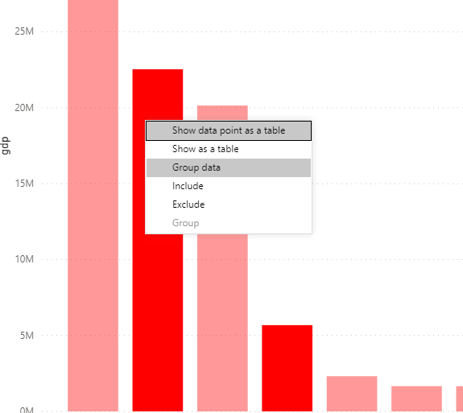
Groups
Select the columns North America and South America , then right click and select
Group the data .

Slide 5
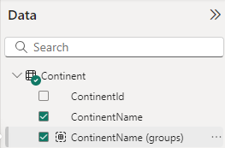
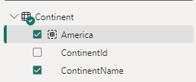
Groups
Continent table level , rename it to America .

Slide 6
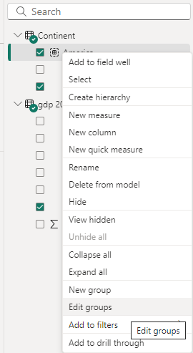
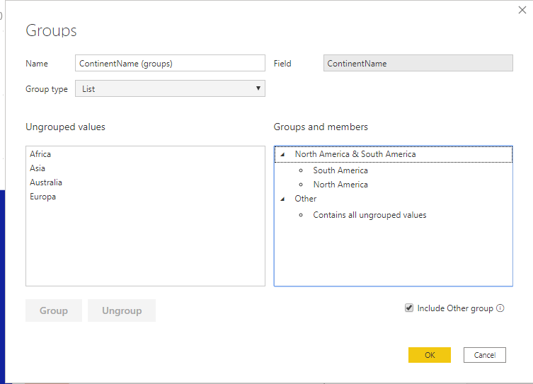
Groups
Right-click on the newly added field and apply Edit Groups .

Slide 7
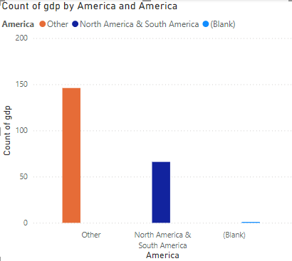
Groups
ContainsName field with the new ContainsName (Groups) field which is now called America in the histogram and observe the change in the data presentation.

Slide 8
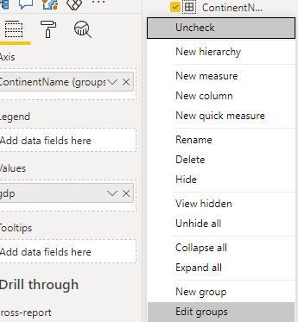
Groups
ContainsName groups (Groups) by right-clicking on them and clicking Edit Groups .

Slide 9
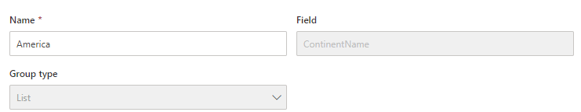
Groups
Note that the group type only displays one option, namely List Only , although it is a drop-down list, and this is because the grouping field is non-numeric. Also note that the option is disabled.
Select Africa in the left panel and click the Group button , keep the name Africa in the new group.
Now create a group that corresponds to each continent to represent the rest of the continents at the same level of the histogram.

Slide 10
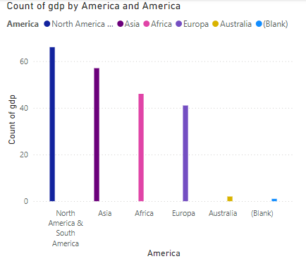
Groups
Now, notice that the histogram changes structure, it now displays all continents.

Slide 11
Groups
Try to delete all Groups and note that this​ is not possible, you will have to have at least
a group in the Groups panel .​

Slide 12
Thank you
Thank you

